Slide 1
Agriculture in Hancock County
Christian Stephenson, Ph.D., C.P.H., C.A.
MSU Extension, Hancock County
(228) 216-8814
C.Stephenson@msstate.edu

Slide 2
What is Agriculture
“Cultivation of the soil, dairying, forestry, raising or harvesting any agricultural or horticultural commodity, including the raising, shearing, feeding, caring for, training and management of livestock, including horses, bees, poultry, fur-bearing animals and wildlife, and the raising or harvesting of oysters, clams, mussels, other molluscan shellfish or fish…”
“the science and art of the production of plants and animals useful to man.”

Slide 3
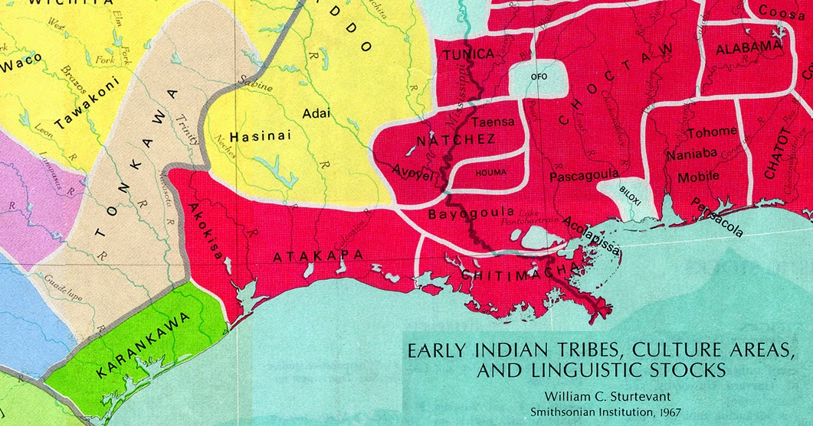
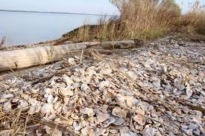
Prehistory
American Indian Tribes:
Biloxi
Pascagoula
Moctobi
Acolapissa
Large piles of shells which they left that they ate oysters and other seafood.
Vegetables: Maize, Squash, Beans
Wildlife: Bear, Dear, Bison

Slide 4
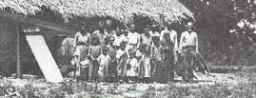
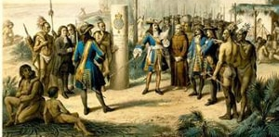
Acolapissa
The Acolapissa, a Muskhogean name meaning “those who listen and see,”
Seven villages on the lower Pearl River in 1699.
Produced corn, beans, squash, melons, and tobacco in small fields due to difficulty in clearing ground and weed control.
Growing season allowed the annual harvest of two to three crops from the same field.
Farming was supplemented by hunting and fishing. Bison were a major meat source.
High population of bison led the French to consider raising them for wool.

Slide 5
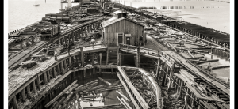
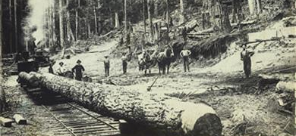
Forestry
Forestry very important to Coastal MS in Antebellum period.
Lumber shipped from Ship Island to New Orleans.
Railroads allowed movement of timber from Piney Woods to the Gulf Coast.
Deepwater port at Gulfport constructed for transport of lumber.
Lumber companies brought in skilled workers from other areas.
Turpentine stills and charcoal kilns.

Slide 6
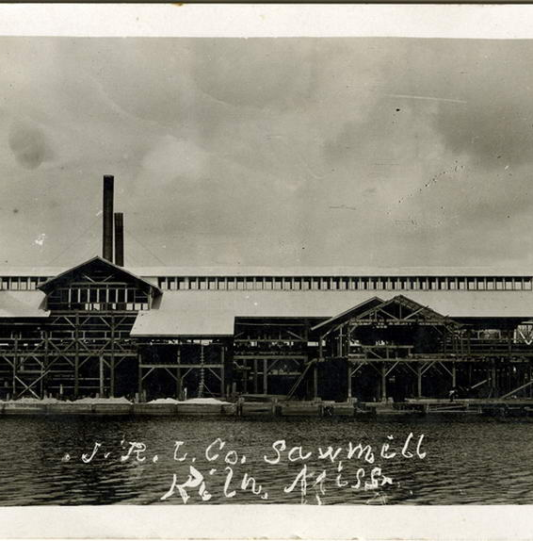

Slide 7
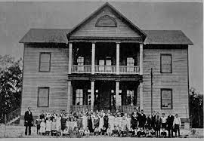
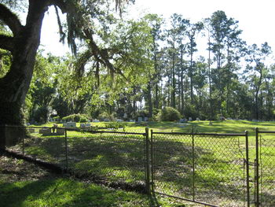
Logtown
Earliest European landowner was Jean Baptiste Rousseve with grant of 1000 arpens.
Town first known as Cabanage Latanier “Palmetto Camp”.
Timber industry led to growth of area in 19th Century.
First sawmill built in 1845
1889, H. Weston Lumber Company founded.
Largest lumber company in the U.S.A., with 1200 workers.
Used 20 barges and 4 ships on Pearl River.
Population declined after lumber exhausted.
Town closed with construction of Stennis Space Center.

Slide 8
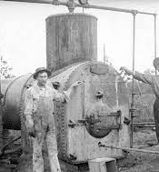
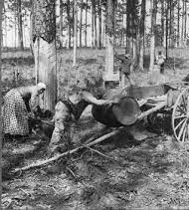
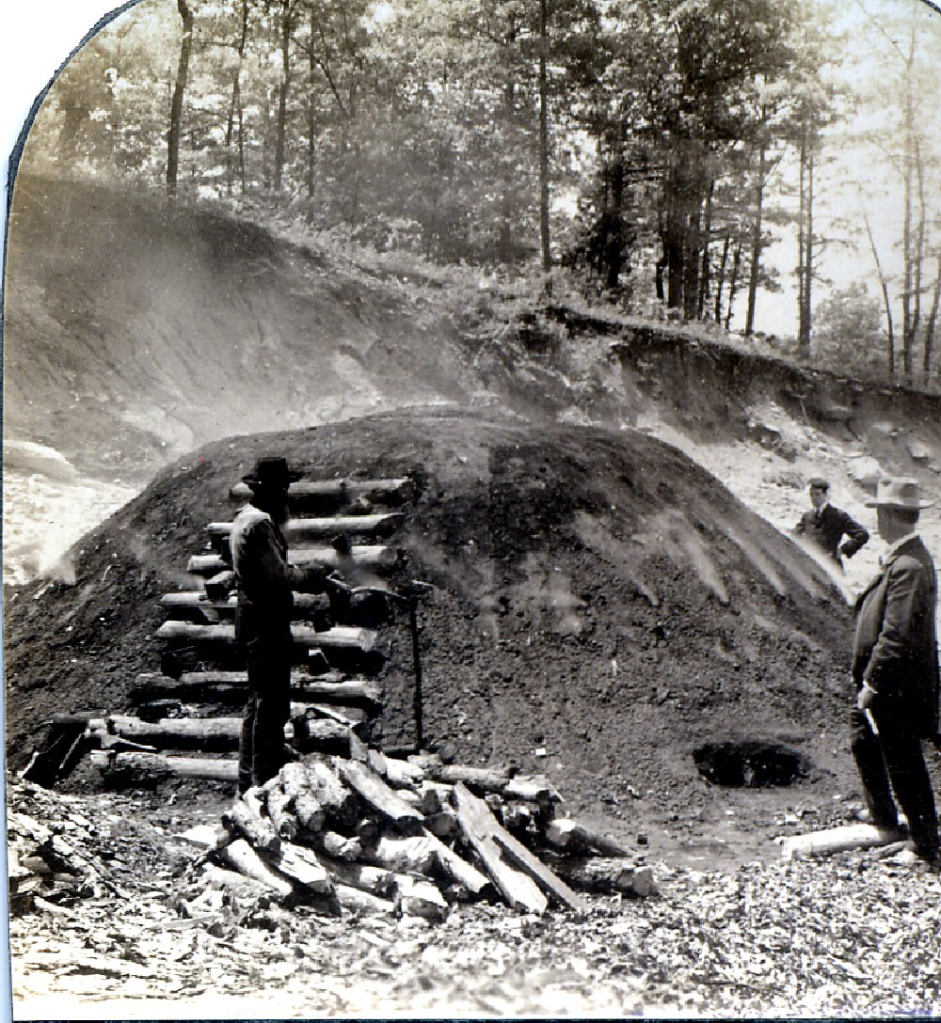
Naval Stores
Products derived from pine resin.
Name comes from materials needed to maintain sailing ships.
Used to manufacture soap, paint, varnish, lubricants, and roofing material.

Slide 9
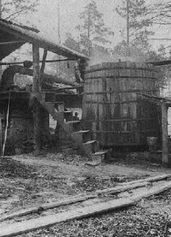
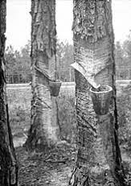
Turpentine Distillation
Distilled from pine resin obtained from cutting trees.
Remnant following distillation is rosin.
Used as a water repellant, wood preservative, solvent, and medicine.

Slide 10
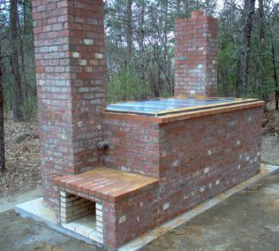
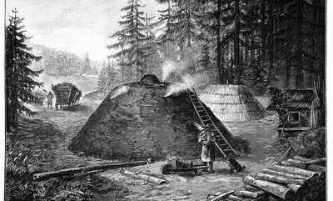
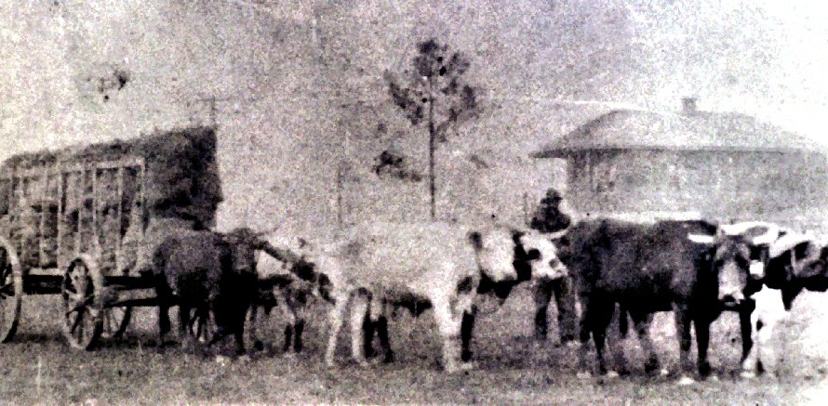
Charcoal Production

Slide 11
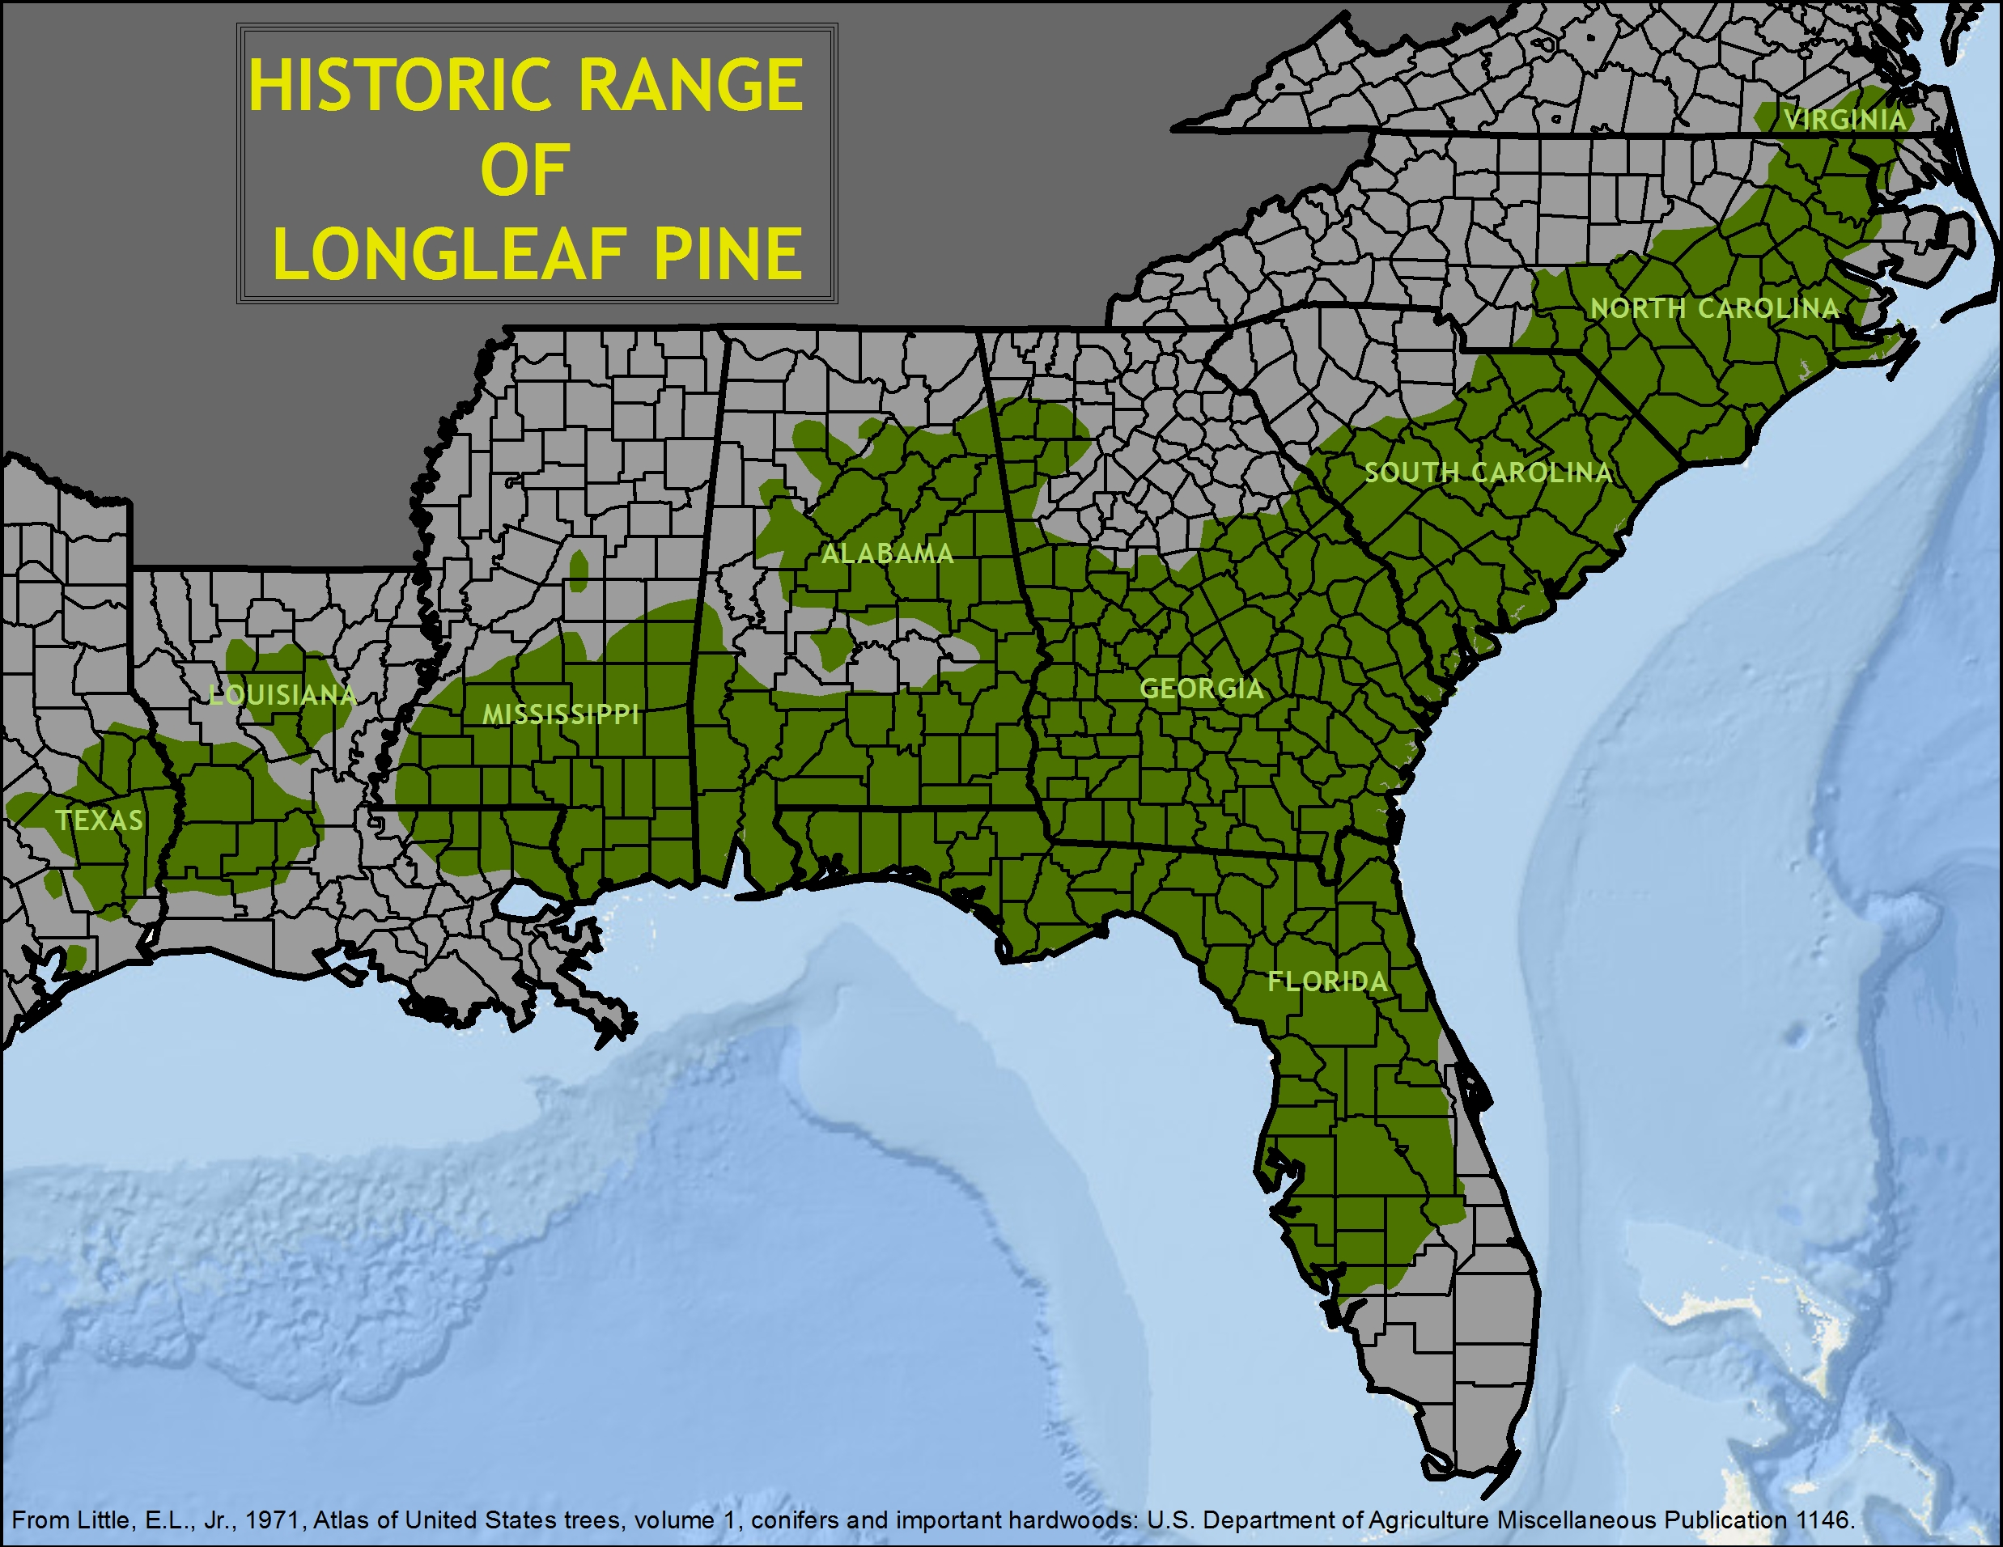
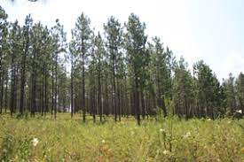
Longleaf Pine Restoration
Longleaf pine (Pinus palustris Mill.) was once one of the most ecologically important tree species in the Southern United States.
Climax temperate coniferous forest habitat
Longleaf pine and its accompanying forest ecosystems covered vast swaths of the Southern United States, spanning an estimated 92 million acres.
Only a fraction of these longleaf pine forests remain today.
Restoration of longleaf pine has both economic and environmental benefits.
Support for diverse species.
Bobwhite quail
Gopher tortoise
High quality pole timber.
Increased value of pine straw.
Longleaf pine has improved insect, disease, storm, and fire resistance.

Slide 12
Specialty Crops for the MS Gulf Coast
Decline of lumber production led to increased interest in specialty crop production
Vegetables
Fruit
Pecans
Transported by ship or rail from Gulfport.
Ocean Springs: Pecans and Citrus
Long Beach: Vegetables, particularly radishes.
Gulfport currently a major entry point for bananas

Slide 13
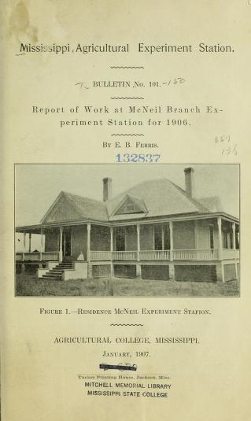
McNeil Experiment Station
“The growing of fruits and vegetables on the cut- over lands of South Mississippi should at some future time reach enormous proportions. The soils of this section of the state are naturally well suited to this class of farming, being sandy loams that drain well, dry out, and warm up very early in the spring, and, therefore, bring the crops grown on them to development much earlier than stiffer lands would do even under the same climatic conditions.“
Ferris, Eugene Beverly, "Truck crops for south Mississippi" (1913). Bulletins. 868.

Slide 14
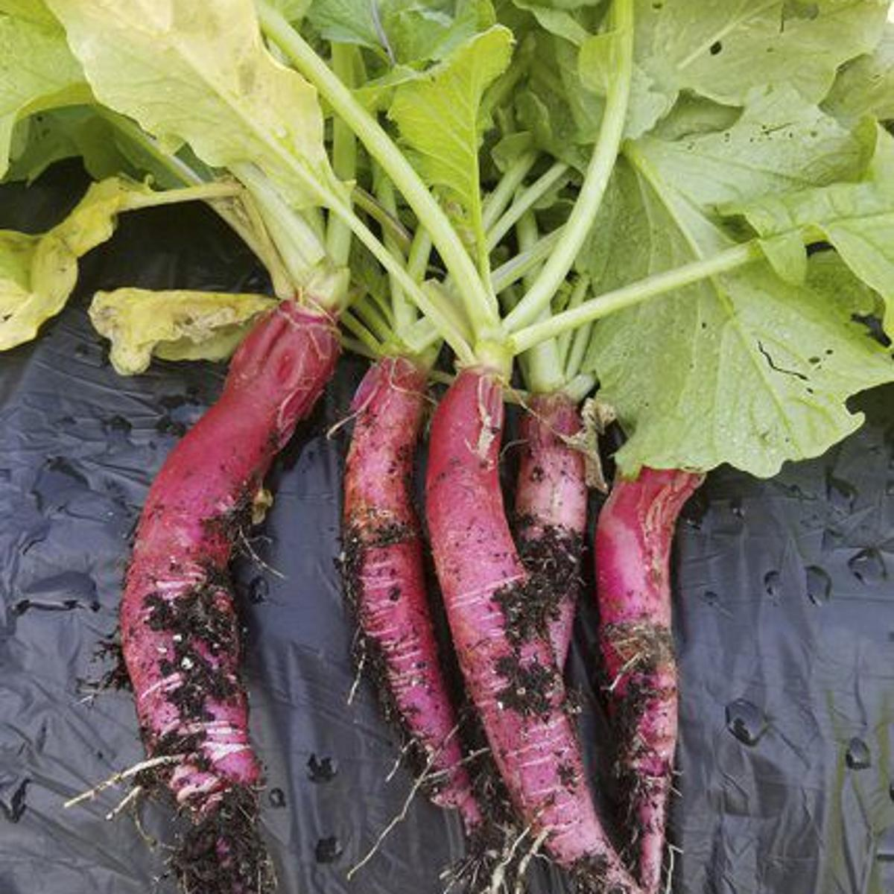
Truck Crop Production on the MS Gulf Coast
Truck farming is the cultivation of one or a few fruit or vegetable crops on a relatively large scale for transport to distant markets where the crop cannot be grown due to climate.
By 1884, Long Beach farms shipping vegetables out by rail
Radish Capital of America due to the popularity of its radishes, the Long Reds used sliced as bar snacks.
In excess of 300 rail cars from 4 crops produced in a season.

Slide 15
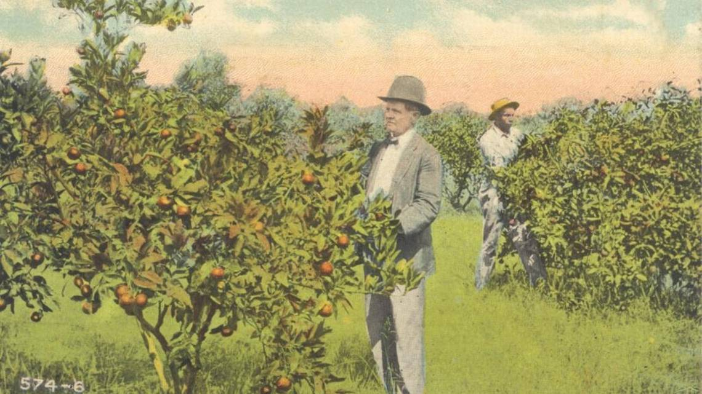
Fruit Production on the MS Gulf Coast
Satsumas were a major crop in 1890s.
Satsuma festival started in Ocean Springs in 1913.
1915 - 40,000 satsumas, 8,000 grapefruit, 300 kumquats in Harrison and Jackson counties.
1915 Hurricane followed by cold weather destroyed significant number of orchards.
Similar cycle in 1930s.
Coastal MS Citrus production now primarily by homeowners.

Slide 16
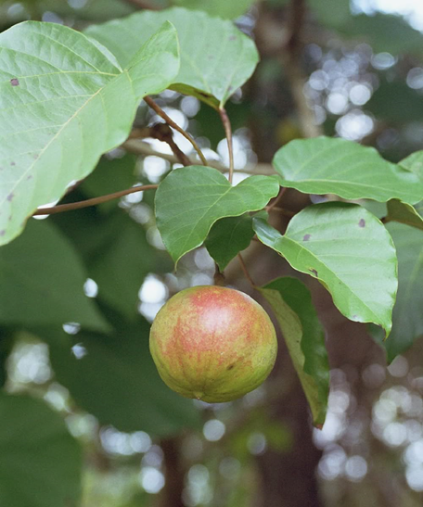
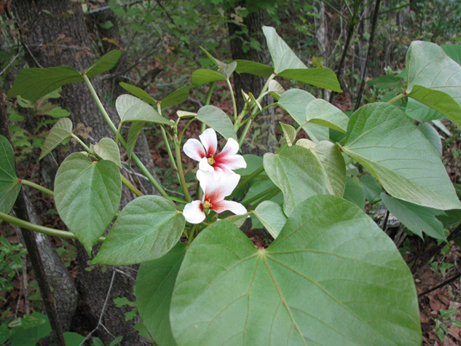
Tung Trees
Introduced into Mississippi in the early 20th Century.
Oil from tung trees used to waterproof wood, in paints and varnishes, making adhesives, as well as in insulators for electric wires.
Tung oil is also used as a drying agent for inks and after processing, as a motor fuel.
Most profitable cash crop grown in its climactic area.
Remained important for Coastal Mississippi through the late 1960s.
Hurricane Camille in August of 1969 resulted in the destruction of as much as 40,000 acres of tung trees.
Increased labor costs and competition from importers led to the end of large scale tung tree production.
Tung trees were grown in Stone County in the mid-1990s but the largest orchard, located near Lumberton, MS was destroyed by Hurricane Katrina in 2005.
At the time that orchard produced 20 percent of the domestic supply of tung oil.

Slide 17
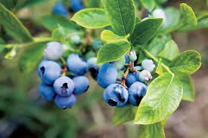
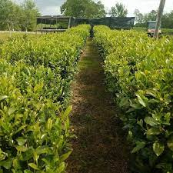
Blueberries
Native to Mississippi.
Research conducted at South MS Research Station beginning in 1970.
Beginning of commercial production.
80 acres in 1981 to 2100 acres in 2014.
U-Pick Operations

Slide 18
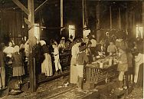
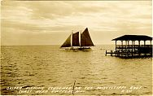
Seafood industry
Seafood industry was strictly local in early 19th Century.
Shipping was not possible as there was no way to prevent spoilage.
Expansion of rail lines and development of ice technology allowed greater reach.
Cannery opened in 1881 based on practices learned by operations in Baltimore, Maryland.
“Bohemian” workers led to doubling of Biloxi population.

Slide 19
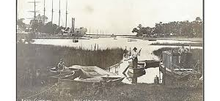
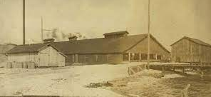
Seafood Capital of the World
In 1890, an annual processing of two million pounds of oysters and 614,000 pounds of shrimp was reported by Biloxi’s canneries.
By 1902, those numbers had skyrocketed as twelve canneries reported a combined catch of 5,988,788 pounds of oysters and 4,424,000 pounds of shrimp.
By 1903, Biloxi, with a population of approximately 8,000, was referred to as “The Seafood Capital of the World.”
By 1904, Biloxi was the world's largest exporter of seafood by tonnage.

Slide 20
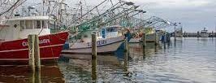
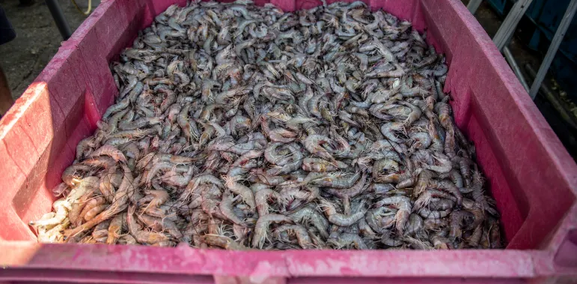
Modern seafood industry
Mississippi commercial landings contributed five percent of the total domestic U.S. landings from 2009 to 2018.
In dockside values, Mississippi added 11 percent to U.S. commercial landing values during the past decade.
Challenges have included Hurricane Katrina, Deepwater Horizon Disaster, and Bonne Carre Spillway opening.

Slide 21
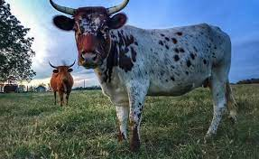
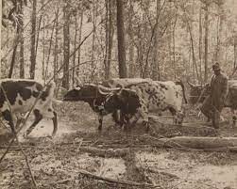
Piney Woods Cattle
One of the oldest breeds of cattle in the United States,
Descend from Spanish cattle brought to the Americas beginning in the early 1500s.
Low-input, extensive cattle-ranging systems typical of Spanish ranching.
Heat tolerant, long-lived, resistant to parasites and diseases, and able to be productive on marginal forage.
Used in the production of beef, and occasionally as dairy cattle. They also played an important role as oxen in the timber industry of the Southeast.
Became rare during the late 1800s and early 1900s, when improved English and European cattle were brought into the Southeast.
Breed nearly became extinct with strains now named for the families that raise them.
The Carter strain, for example, began in the 1860s when Print Carter, a sixteen year old Civil War veteran, swam a herd of red cows over the Pearl River and began raising cattle.

Slide 22
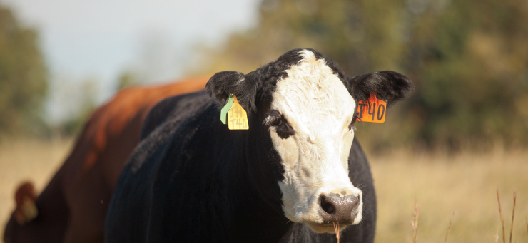
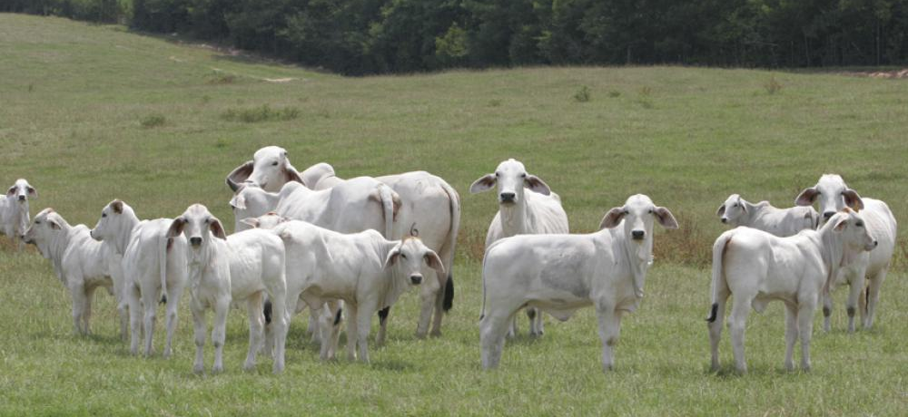
Cattle Production
Cow-calf operations consist of mother cows that give birth to calves annually.
Stocker cattle operations include weaned calves fed to higher weights before moving to a feedlot.

Slide 23
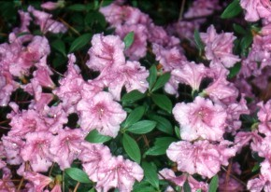
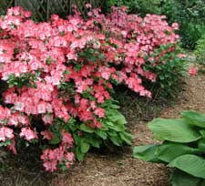
Back Acre Hybrids
Pass Christian, Mississippi
B. Y. Morrison
More than 50 cultivars
Wide array of flower colors and unusual color combinations
Many have frilled or double flowers.

Slide 24
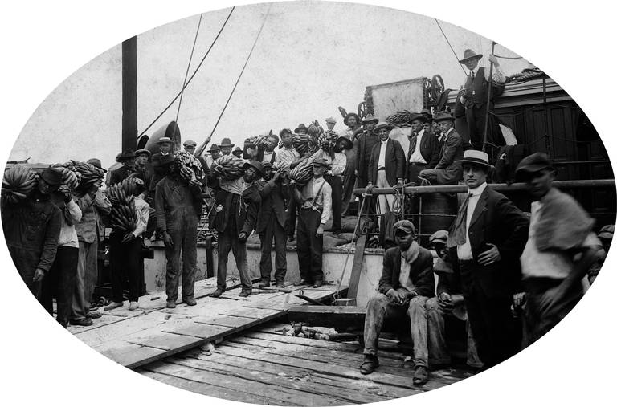
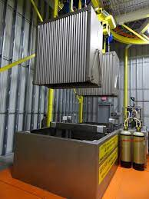
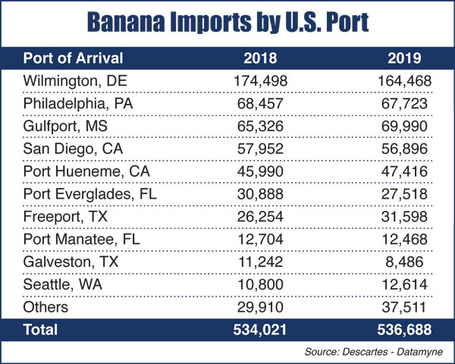
Shipping of Agriculture Products
Port of Gulfport
By 1907, Gulfport shipped more pine lumber than any port in the world.
360 million board feet shipped from Gulfport in 1911.
Bananas, pineapples, other fresh produce, frozen poultry and pork, cotton, and paper.
Food preservation.

Slide 25
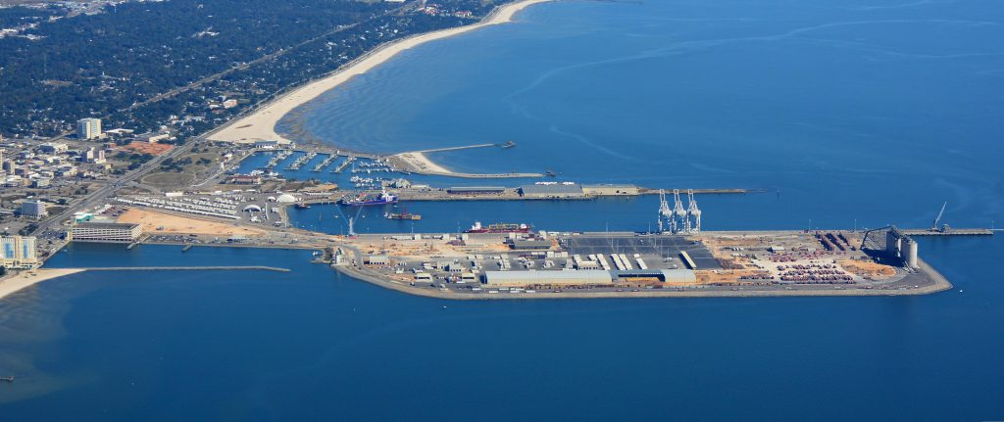
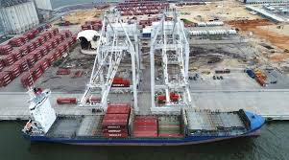

Slide 26
Current Agriculture in Hancock County
287 Farms
Average Farm Size - 113 acres
Farmers – 460
New and Beginning Farmers – 131 (Less than 10 years)
County ranked 79th of 82 in Mississippi
Vegetables, melons, potatoes, sweet potatoes - $156,000
Fruits, tree nuts, berries - $379,000
Hay - $403,000
Dairy - $480,000
Cattle - $2,583,000
Other - $477,000

Slide 27
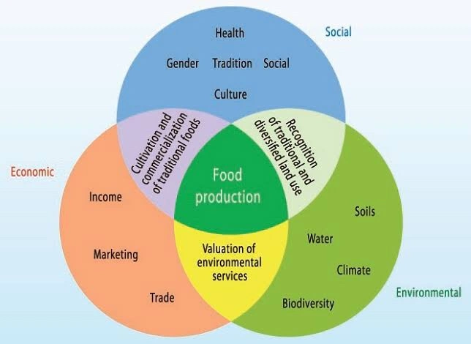
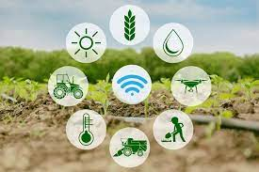
The Future
“It’s tough to make predictions, especially about the future”
Yogi Beara
“History doesn’t repeat itself, but it often rhymes”
- Mark Twain
Local food movements
Diversification
Increase in technology adoption
Sustainability

